Slide 1

UX202 - Building Gateway Services Graham Robinson Yelcho Systems Consulting

Slide 2
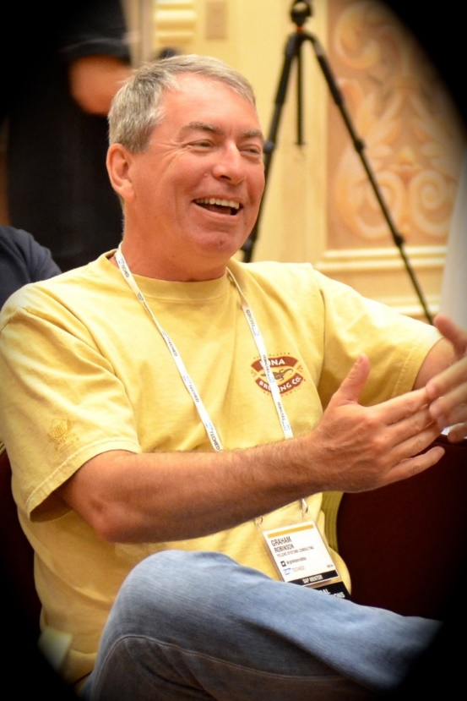



Introduction
@grahamrobbo
*Photo by Martin Gillet

Slide 3
Agenda
Some Warnings
Service Design
Code patterns for reusability
Code patterns for extensibility

Slide 4
Agenda
Some Warnings
Service Design
Code patterns for reusability
Code patterns for extensibility

Slide 5
Warning – This is not For Beginners

Slide 6
Warning – focus on consumption
These code patterns can apply to all actions – but I will focus on consumption
GET_ENTITYSET is more complex because it needs to supports oData query options
CDS views (NW 7.40 SP8) provide other consumption options

Slide 7
Warning – I do not have all the answers

Slide 8
Agenda
Some Warnings
Service Design
Code patterns for reusability
Code patterns for extensibility

Slide 9
Service Design Principles
Design for Consumers
Think oData i.e. Entities, Associations, etc.
Leave SAP domain knowledge at the door
REST API’s should be self-describing
Function Imports should be for special cases

Slide 10
General Theory of API Design

Slide 11
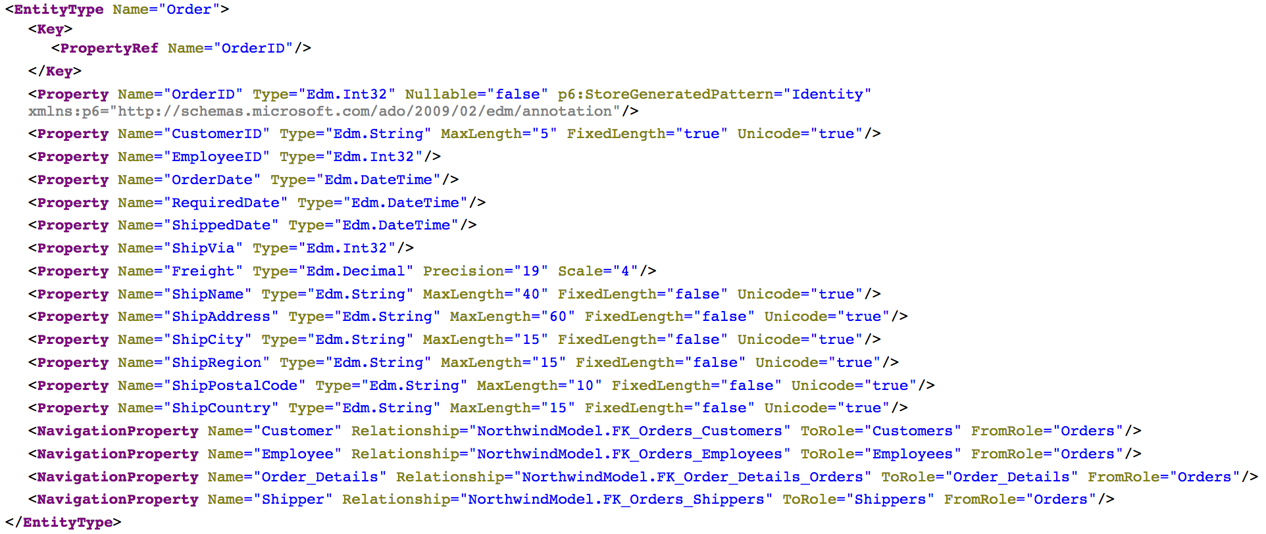
Consumer View of API
Source: http://services.odata.org/northwind/northwind.svc/$metadata

Slide 12
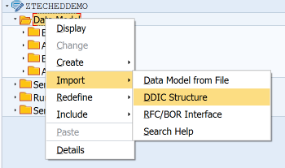
Bind Entity to DDIC Structure

Slide 13
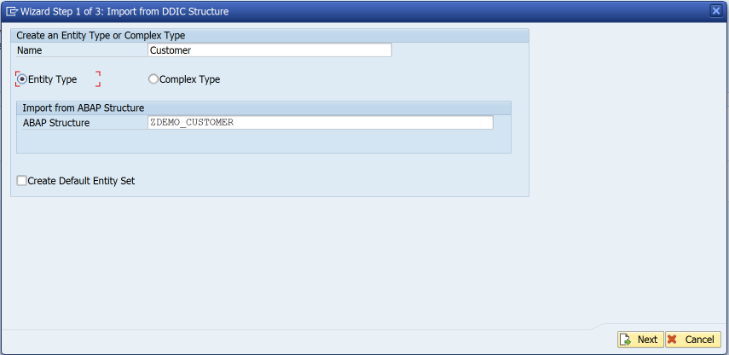
Bind Entity to DDIC Structure

Slide 14
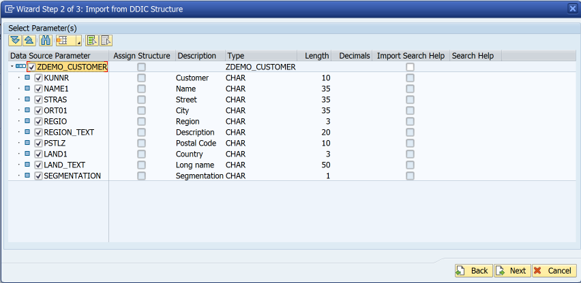
Bind Entity to DDIC Structure

Slide 15
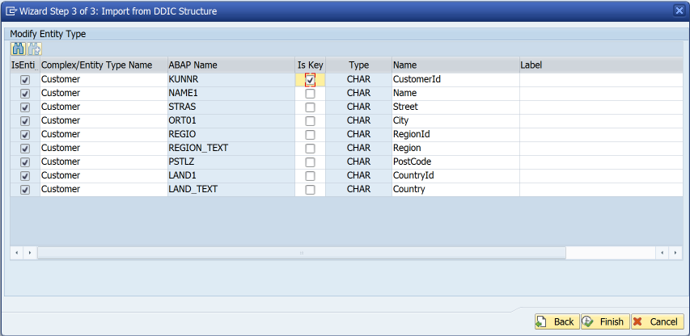
Bind Entity to DDIC Structure
Remove label suggestions
This means labels are determined at runtime rather than design-time

Slide 16
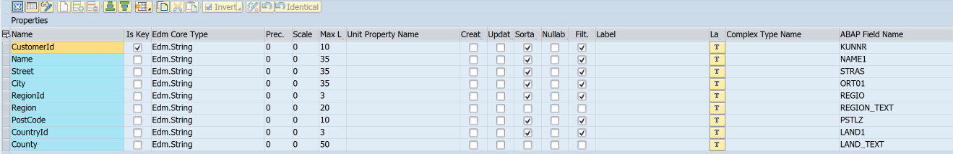
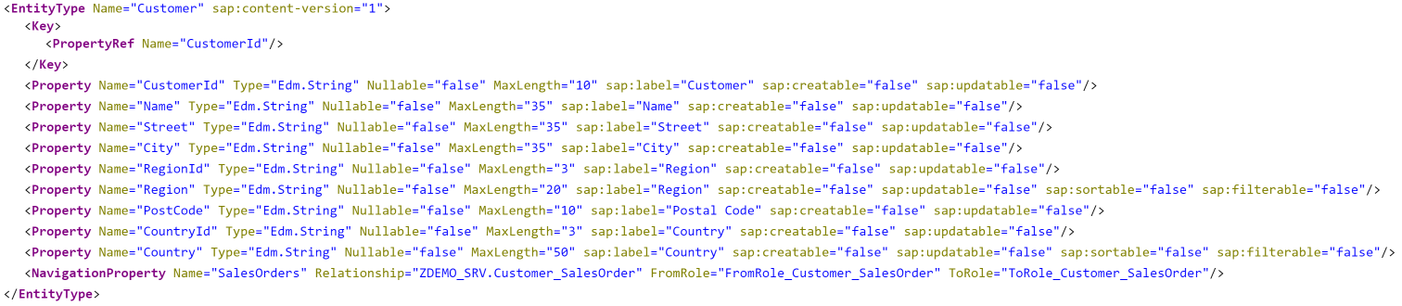
$metadata

Slide 17
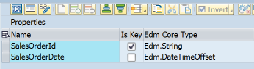
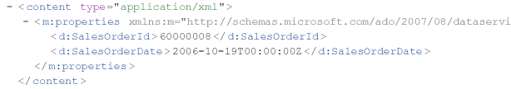
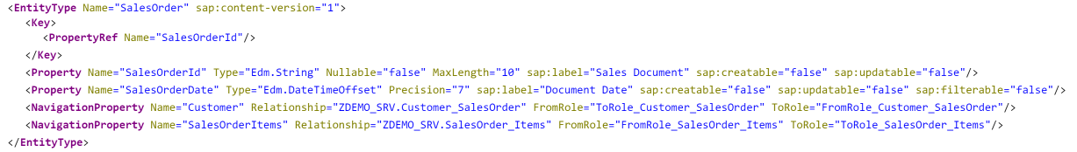
Dates & Times
Use Edm.DateTimeOffset for date/time/timestamp properties
Don’t be tempted to use Edm.String “for convenience”
Edm.DateTime replaced in oData V4 specification

Slide 18
Agenda
Some Warnings
Service Design
Code patterns for reusability
Code patterns for extensibility

Slide 19
Code patterns for Reusability
The first rule of reusability is encapsulate all business logic in concrete classes

Slide 20
What a class is not
An ABAP class that only contains static methods is not really a class…..
… in all respects except it’s object type it is a...
Function Group

Slide 21
Code patterns for Reusability
The second rule of reusability ENCAPSULATE ALL BUSINESS LOGIC IN CONCRETE CLASSES

Slide 22
Code patterns for reusability
I like the singleton design pattern in ABAP
Be aware that some people don’t
I don’t care – it works for me
I like getters (& sometimes setters)
Be aware that some people don’t
I don’t care – it works for me
You can implement business logic however you like… just remember the first & second rules of reusability

Slide 23
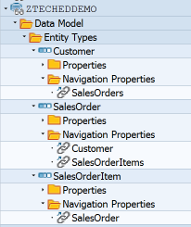
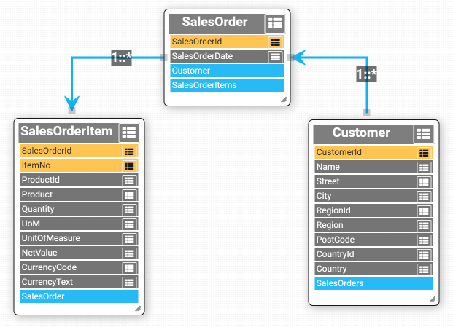
Sample Data Model

Slide 24
Data Provider Class
DPC
Class

Slide 25
Multiple consumers
DPC
DPC
DPC
Class

Slide 26
Multiple consumers
DPC
DPC
DPC
Common Interface
Class

Slide 27
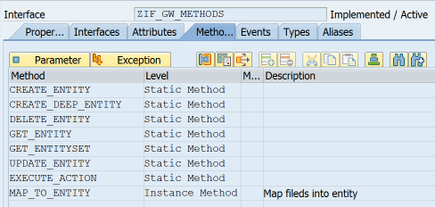
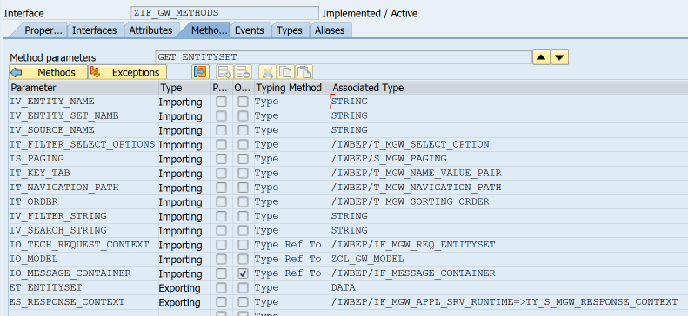
Common Interface
Model
Message Container
Untyped data object

Slide 28
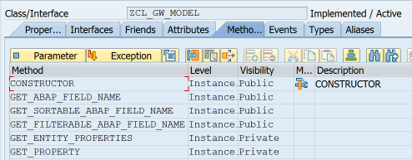
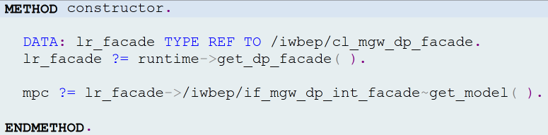
ZCL_GW_MODEL

Slide 29
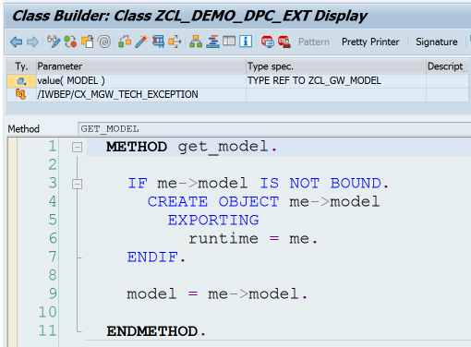
DPC->GET_MODEL

Slide 30
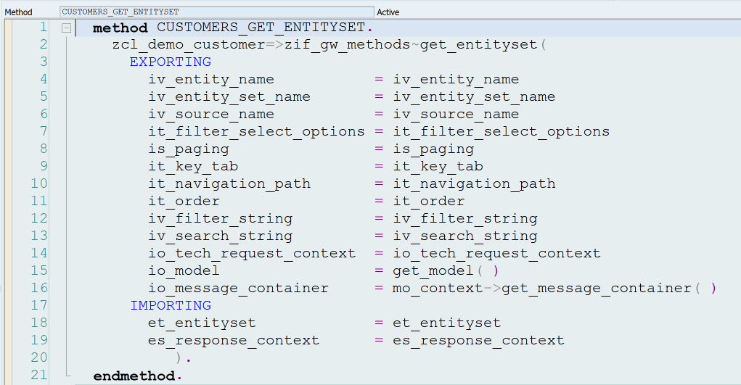
Call BO Class from DPC

Slide 31
oDATA Operations
 | Identify Primary Key(s) | Instantiate Class | Call class methods | Fill Entity
Create
Read
Update
Delete

Slide 32
get_entity
Identify primary key(s)
Instantiate class
Fill entity

Slide 33
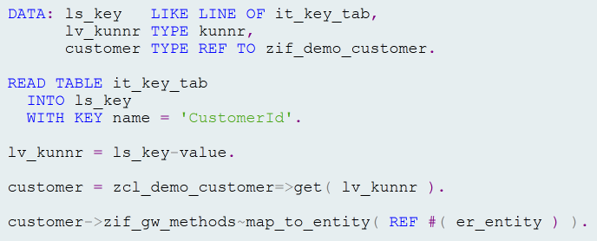
get_entity V1

Slide 34
get_entity V1 – Identify Primary Key

Slide 35
get_entity V1 – Instantiate BO Class

Slide 36
get_entity V1 – Fill Entity

Slide 37
get_entity V1

Slide 38
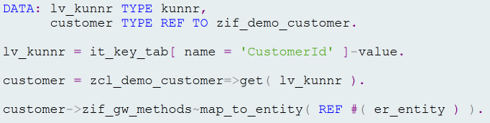
get_entity V2 – Table Expressions

Slide 39
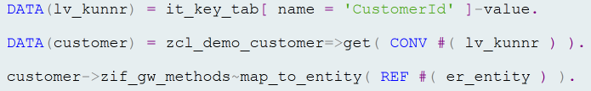
get_entity V3 – Inline Declarations

Slide 40
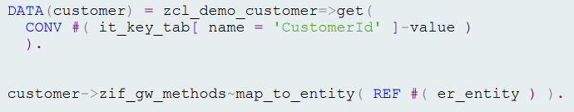
get_entity V4
For update operation we would call class methods here

Slide 41
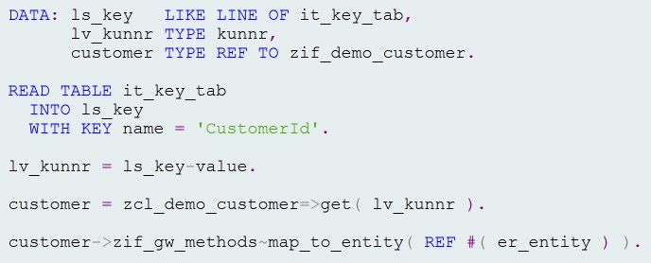
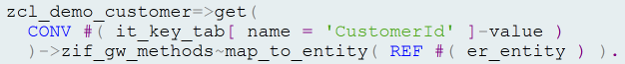
get_entity V5 – Method Chaining

Slide 42
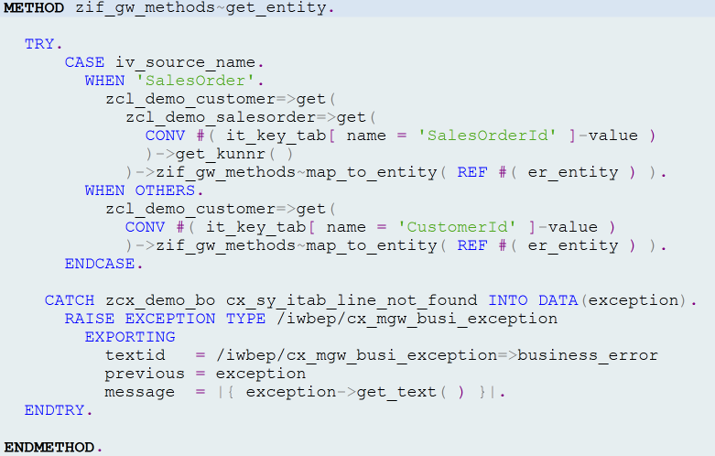
zif_gw_methods~get_entity
Use salesorder key to get customer key

Slide 43
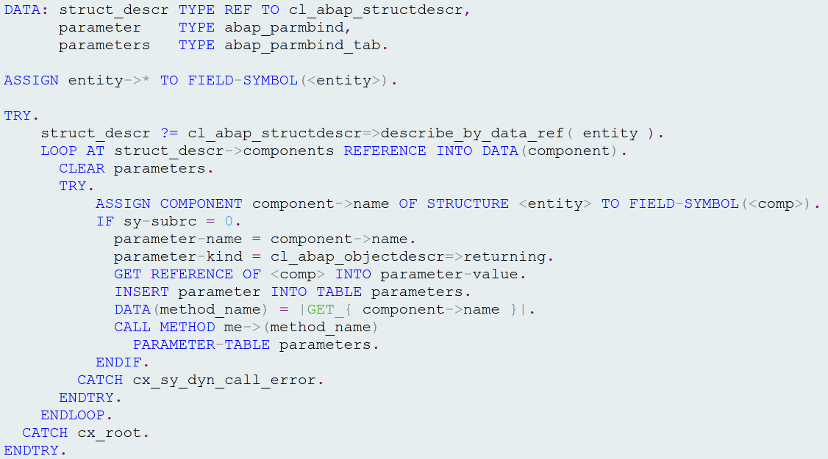
Call_all_getters

Slide 44
GET_EntitYSET

Slide 45
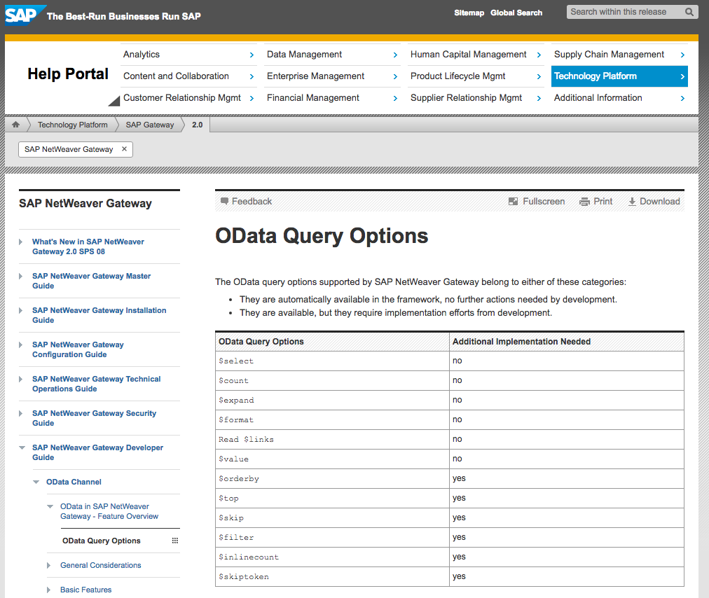
oData Query Options

Slide 46
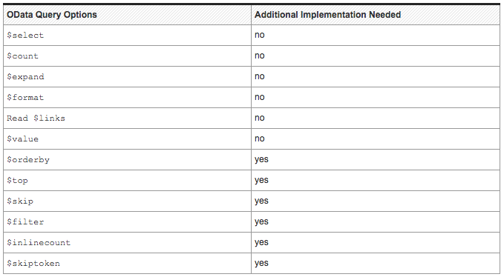
oData Query Options

Slide 47
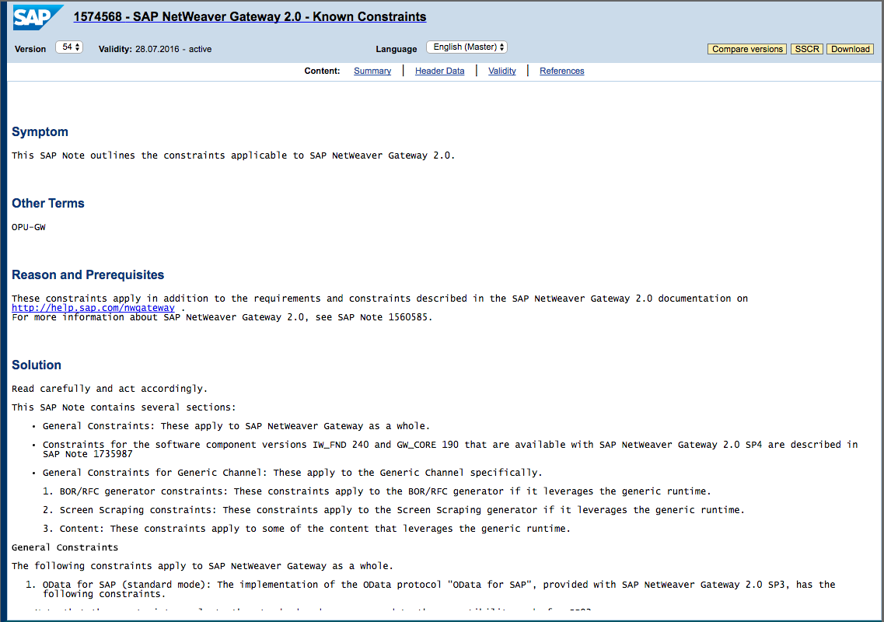
Known Constraints
SAP Note 1574568

Slide 48
zif_gw_methods~get_entityset
Create anonymous data object
$orderby
$filter
$inlinecount
$top & $skip
$count
$skiptoken
Fill entities

Slide 49
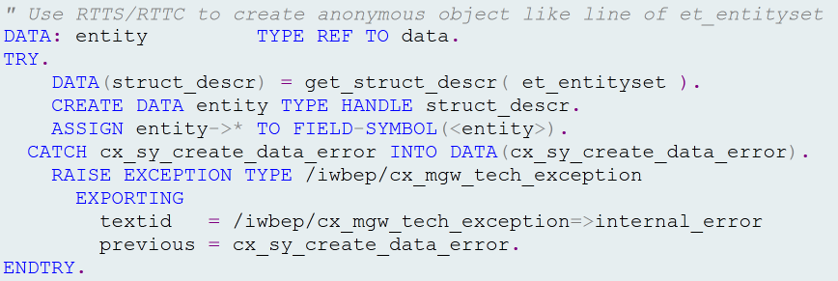
Create Anonymous data Object

Slide 50
$orderby

Slide 51
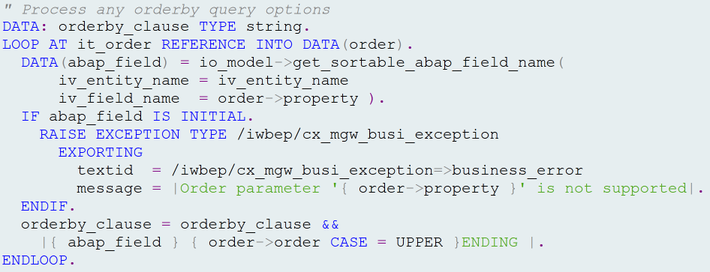
$orderby

Slide 52
$filter

Slide 53
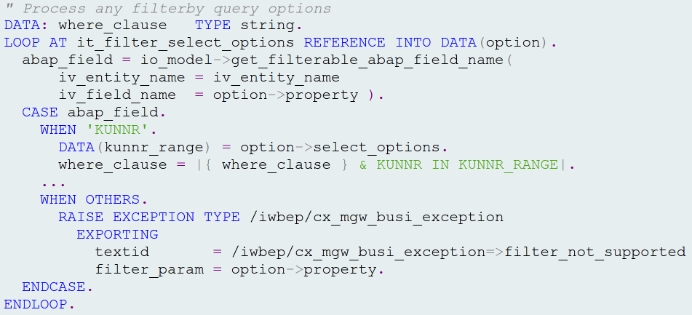
$filter

Slide 54
Complex $filter Queries
$filter=substringof(‘G’,Name) or substringof(‘R’,Name)

Slide 55
$Inlinecount

Slide 56
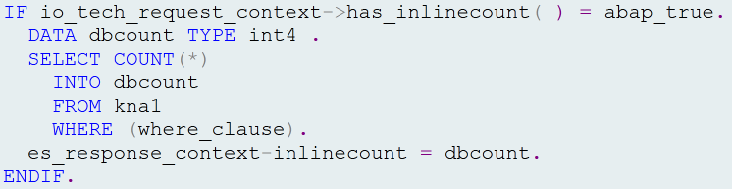
$inlinecount

Slide 57
$top & $skip

Slide 58
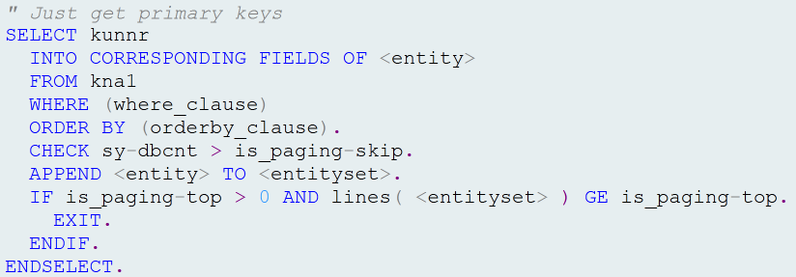
$top & $skip

Slide 59
$count

Slide 60
$count

Slide 61
$count

Slide 62
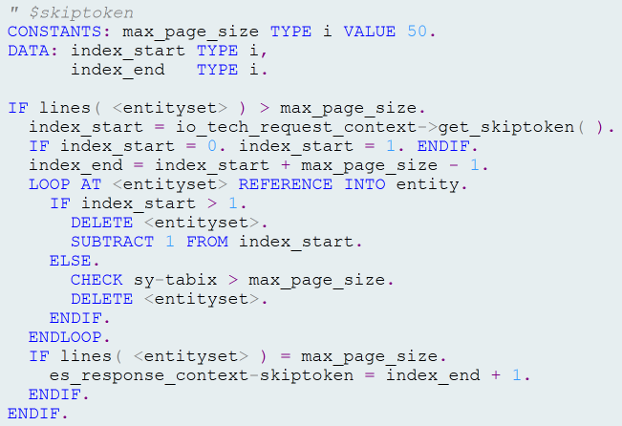
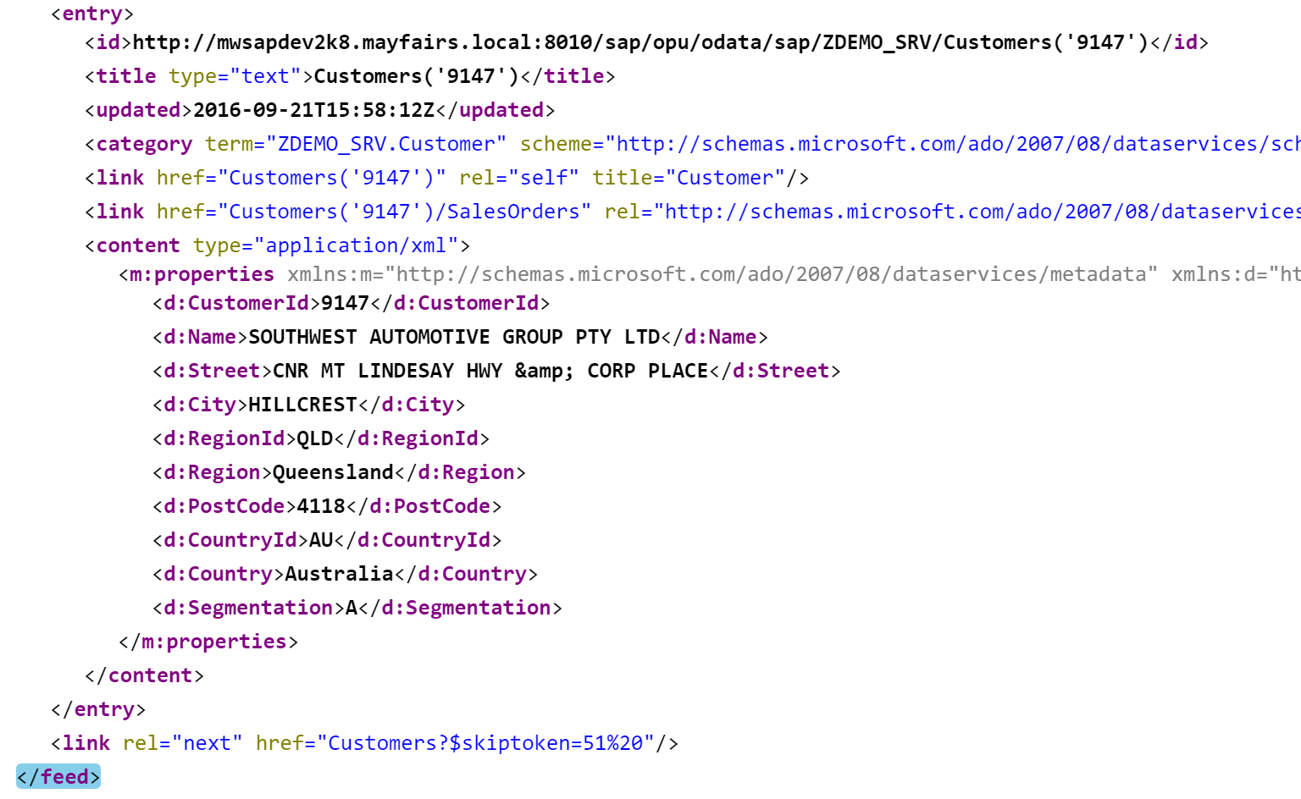
$skiptoken

Slide 63
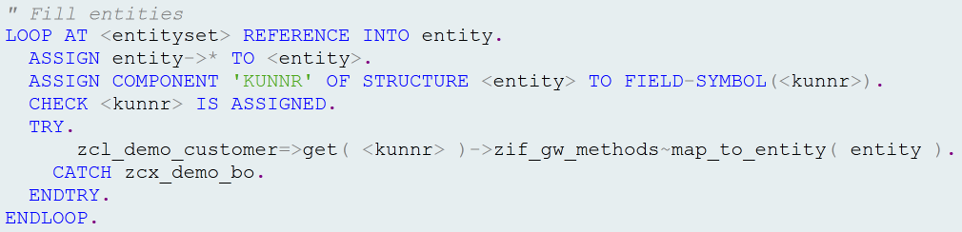
Fill Entities

Slide 64
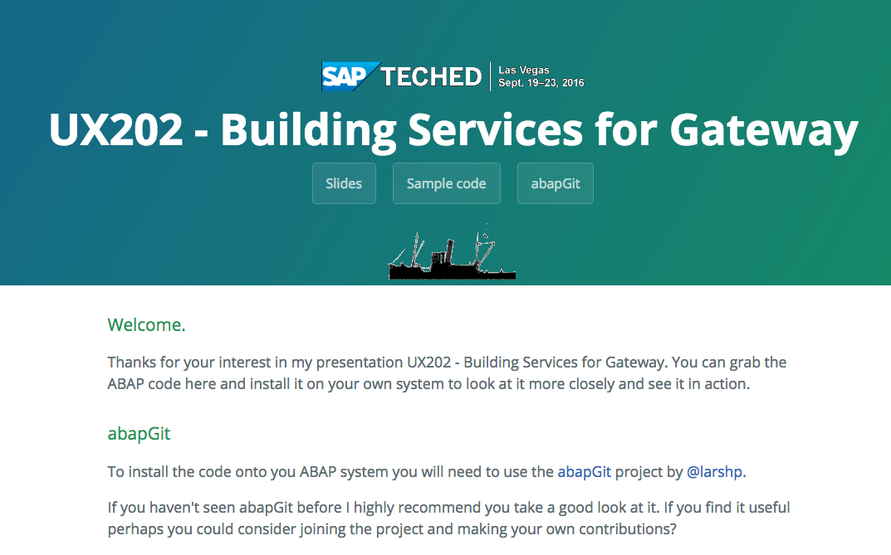
Where is the code?
https://grahamrobbo.github.io/teched16_example/
You will also need abapGit
https://abapGit.org

Slide 65
Agenda
Some Warnings
Service Design
Code patterns for reusability
Code patterns for extensibility

Slide 66
Code Patterns for Extensibility
Mainline code built on central development server
Mainline code deployed to customer system via abapGit
Need to be able to add customer-specific code without changing mainline code

Slide 67
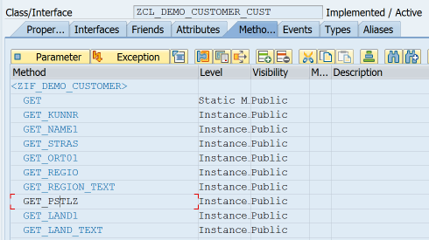
BO Class subclass
New methods or redefine existing methods

Slide 68
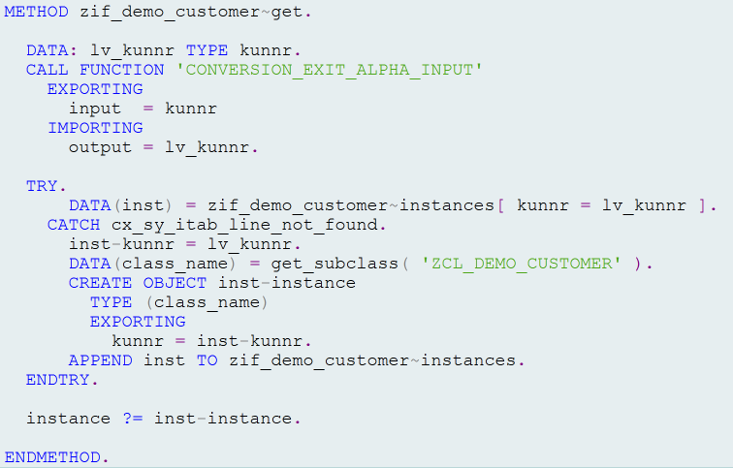
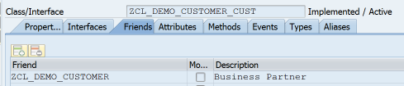

BO Class INSTANTIATION

Slide 69
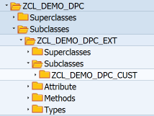
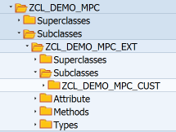
DPC & MPC classes

Slide 70
DPC & MPC subclasses

Slide 71
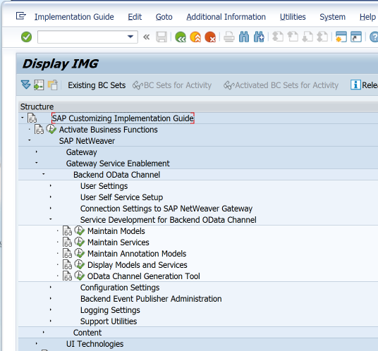
Maintain GW Models & Services

Slide 72
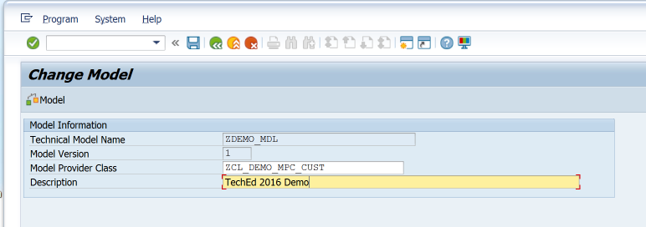
/IWBEP/R_DST_MODEL_BUILDER

Slide 73
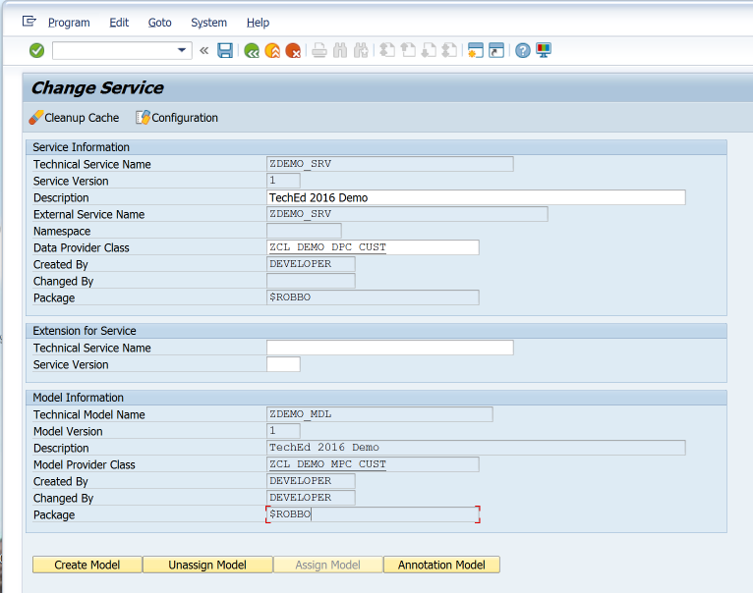
/IWBEP/R_DST_SERVICE_BUILDER

Slide 74
Extend GW Service
Create or Enhance DDIC structure
Enhance model definition in MPC
Add code to fill new entities/properties

Slide 75
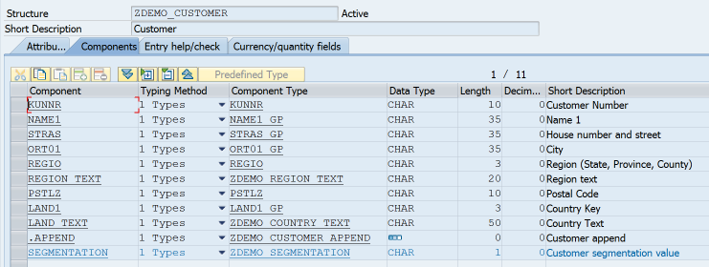
Enhance DDIC Structure

Slide 76
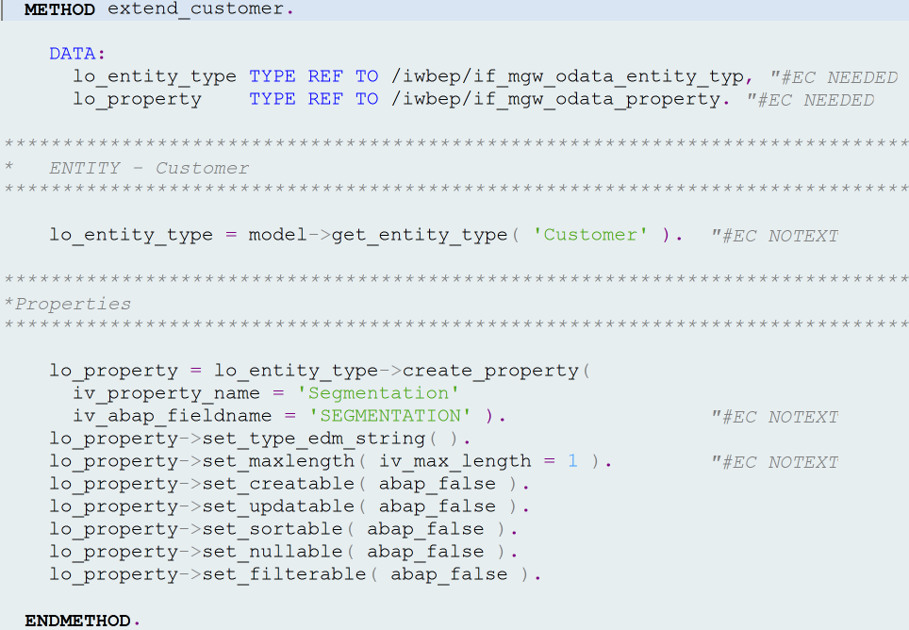
Enhance Model

Slide 77
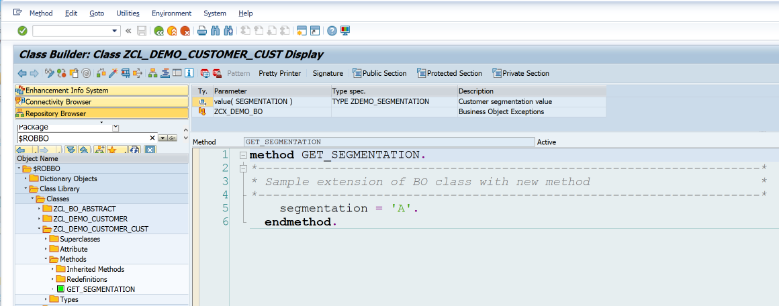
Fill new property

Slide 78
Summary
Service Design
Design for consumers
Code patterns for reusability
The first & second rule
Code patterns for extensibility

Slide 79
Where is the code?
https://grahamrobbo.github.io/teched16_example/
You will also need abapGit
https://abapGit.org

Slide 80



@grahamrobbo
Photo by Frank Hurley – used with permission

Slide 81

FOLLOW US
Thank you for your time
Follow us on at @ASUG365

